Slide 1
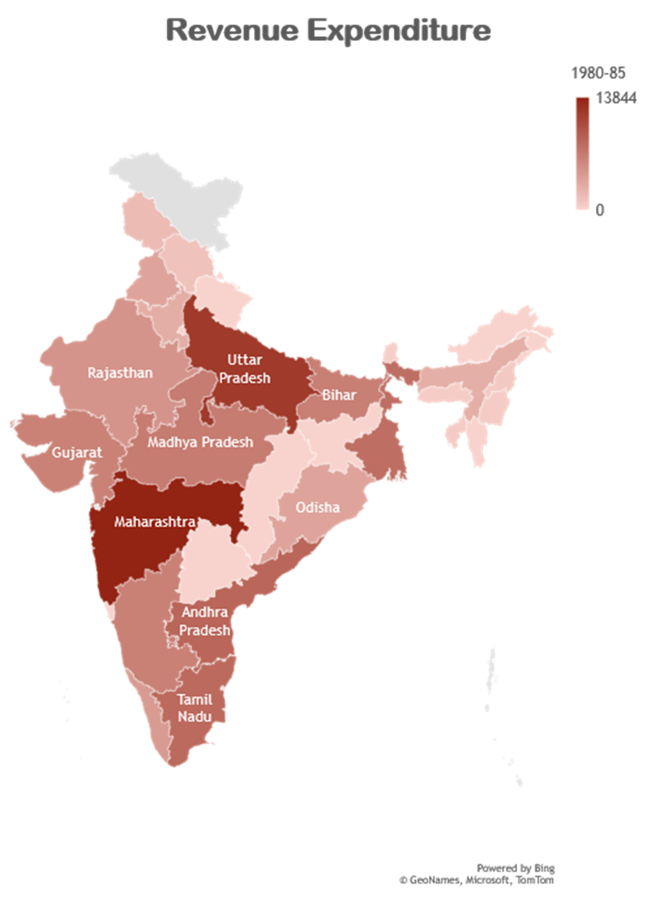

FINANCIAL ANALYSIS
Different States of INDIA (1980 – 2016)

Slide 2
The most 2 important financial metrics
GROSS FISCAL DEFICIT
CAPITAL EXPENDITURE
The excess of total expenditure including loans net of recovery over revenue receipts (including external grants) and non-debt capital receipts
Capital expenditure is the money spent by the government on the development of machinery, equipment, building, health facilities, education, etc. It also includes the expenditure incurred on acquiring fixed assets like land and investment by the government that gives profits or dividends in future

Slide 3

Revenue Expenditure
Revenue expenditures are short-term expenses that are also known as revenue expenses and operational expenses (OPEX).
It involves all costs that are required for the successful running of a business such as salaries for employees and property taxes. Revenue expenditure is recorded during an accounting period or a single year.

Slide 4
TOP 2 STATES WITH UPWARD AND DOWNWARD TREND FOR GROSS FISCAL DEFICITS

Slide 5
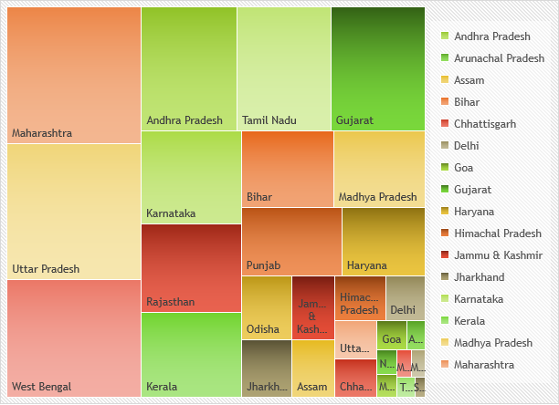
Correlation between Fiscal Deficits and Capital Expenditure
The net fiscal deficit is the gross fiscal deficit less net lending of the Central government.
Generally fiscal deficit takes place either due to revenue deficit or a major hike in capital expenditure.
Capital expenditure is incurred to create long-term assets such as factories, buildings and other development.

Slide 6
5 year termly analysis of different Financial Metrics

Slide 7
Aggregate Expenditure

Slide 8
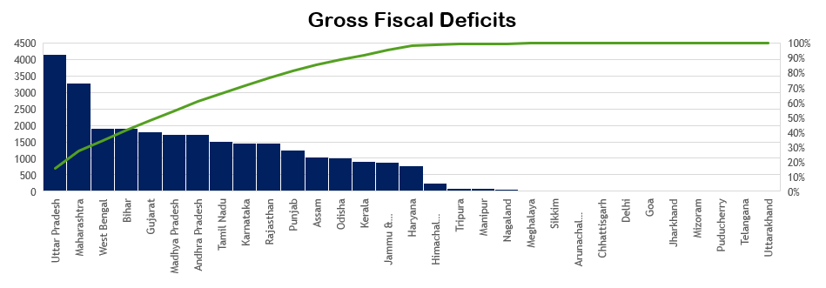
Own Tax Revenues

Slide 9
Top 10 states with highest gross fiscal deficit

Slide 10
Correlation between social sector expenditure and tax revenues for different state

Slide 11
CONCLUSION
The past data has to be seen to model growth of the Country. One of the major aspects while taking a right investment decision is to analyze the financial statements of any company who came to invest in India.
The budgeted reduction in deficit indicators is based on increases in tax revenues and disinvestment proceeds, and containment of the growth in expenditure. At the same time, enhanced budgetary allocations have been made for the farm and rural sectors, the social sector, infrastructure and employment generation.
As per Analysis ‘UTTAR PRADESH’ & ‘MAHARASTRA’ are most revenue generating states for India.
On the basis of our analysis we conclude that some of states showing positive Fiscal Deficit and some of them showing negative Gross Fiscal Deficit.

